Slide 1
Remaining Notes
If you haven’t submitted any CGIs, or got feedback and want to resubmit, you may do so, but be aware:
You might get a slight late penalty for resubmitted assignments labeled Weeks 1-11, but it won’t be much (I’d rather you did these, in part because it’s good review for the final interview)
Make sure you email me if/when you’ve resubmit so I know to look.
Week_12.ClimateStats and Week_13.Cambio4.0 are not included in the score tallies on Canvas
All course materials (CGIs and presentation links) have to be in by 5 pm Wednesday Dec. 11 (University policy)
This week, we’ll split our time between reviews and group work on your projects

Slide 2
A birds-eye view of the course
Code
Theory
Reality

Slide 3
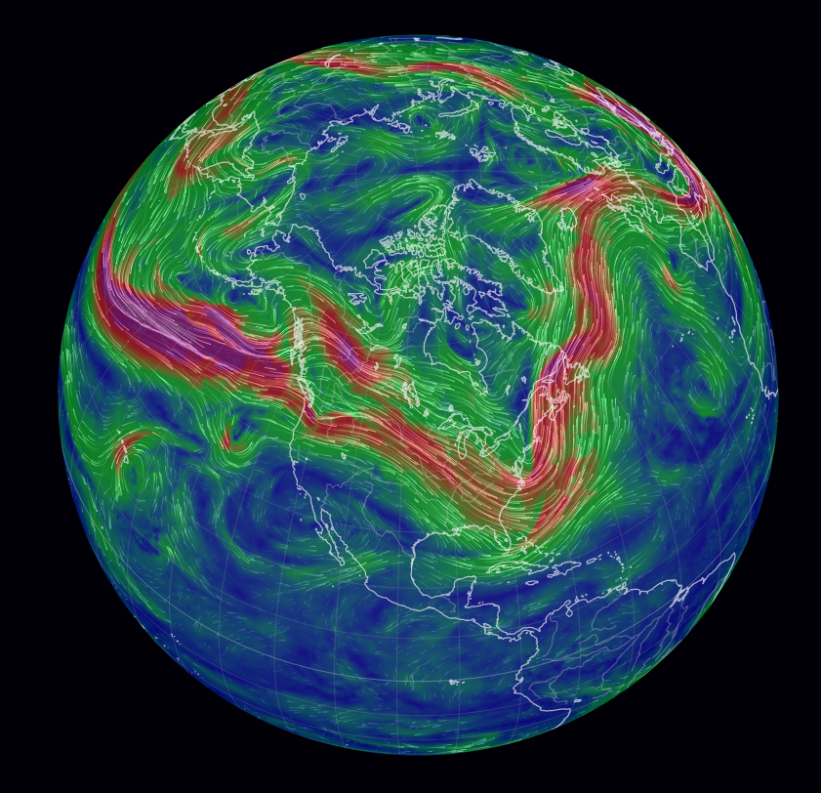
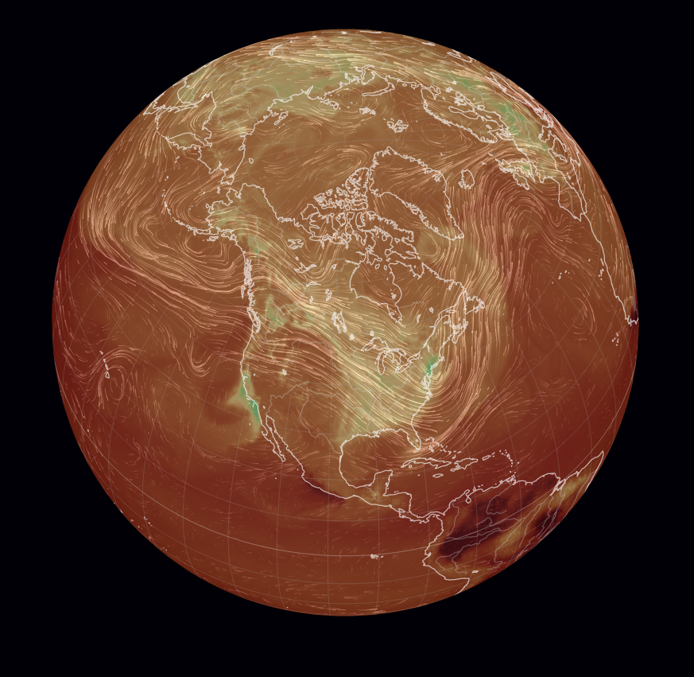
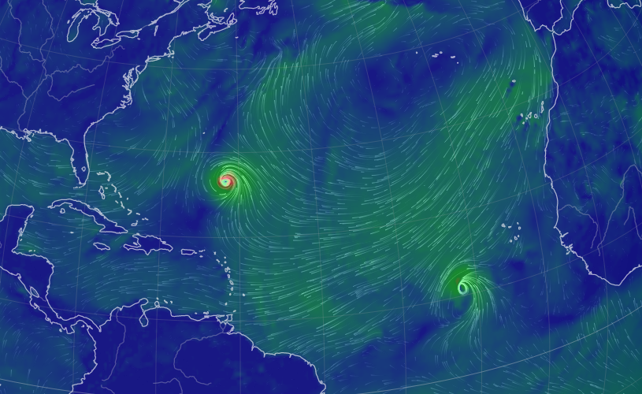
Week 1 - From weather to climate
Synoptic systems
Upper-atmosphere winds
CO₂ and other pollutants

Slide 4
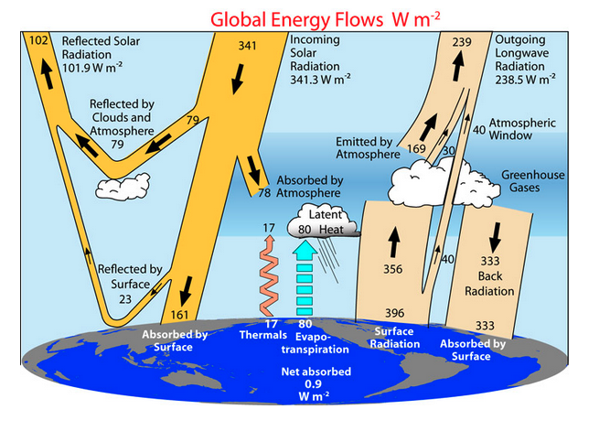
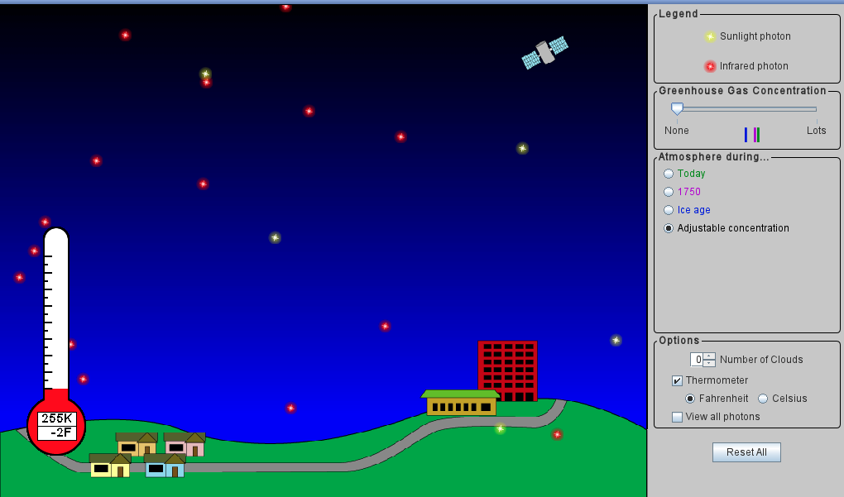
Week 2 - Radiative balance
Key lesson learned: If albedo drops by just 0.01 (say, from 0.3 to 0.29), expect temperature increase of +1 ºC.

Slide 5
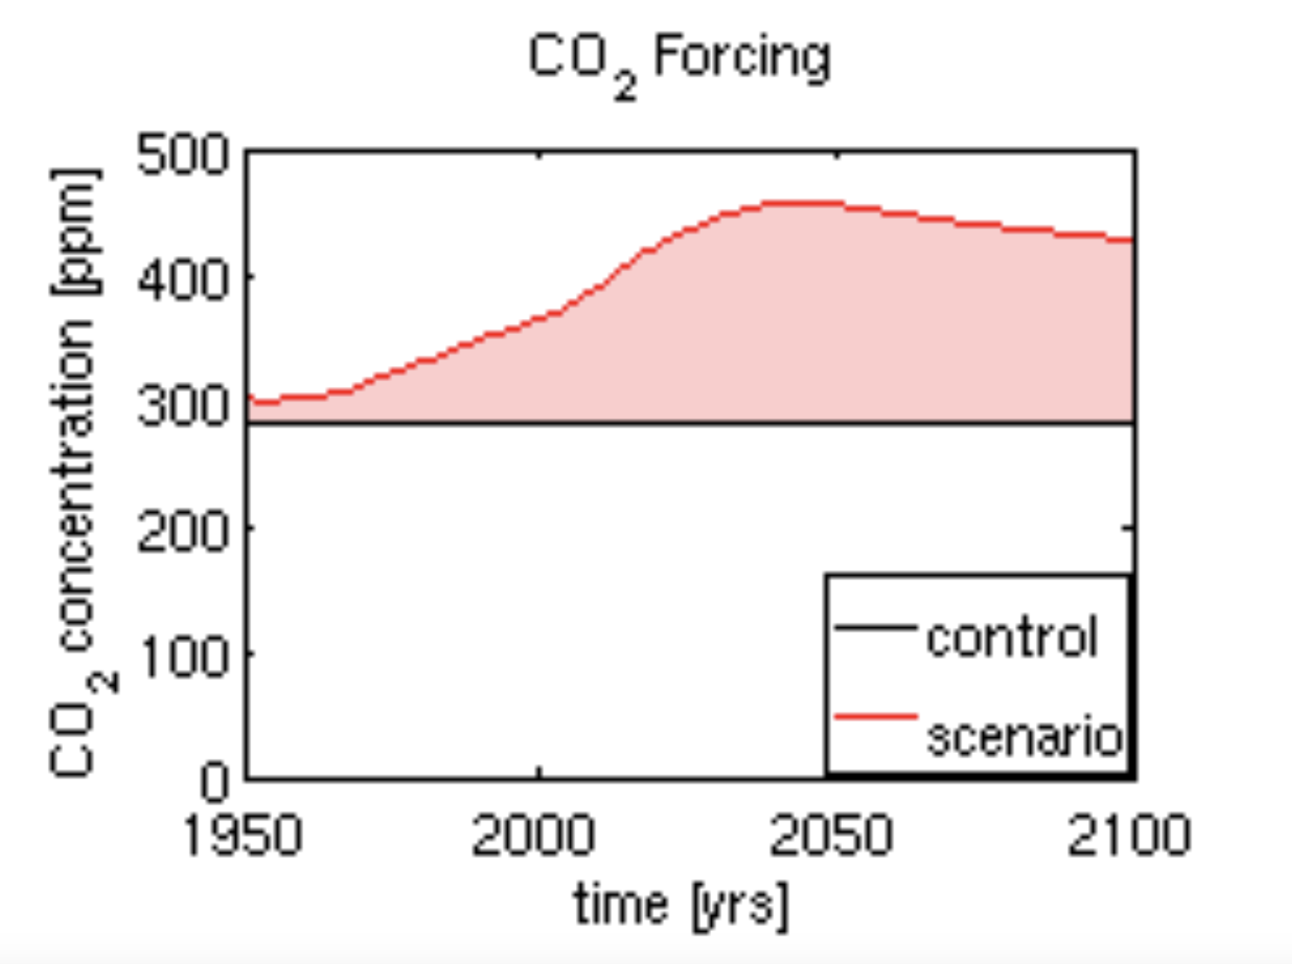
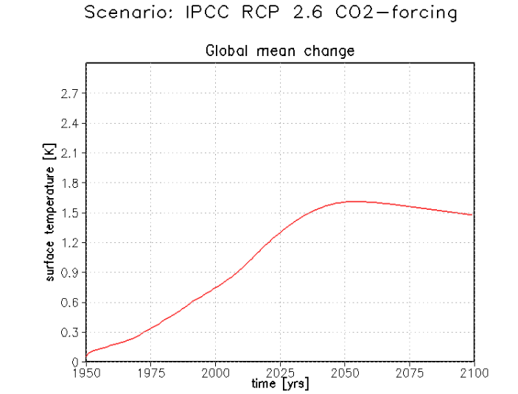
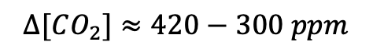

Week 3 – Canned models (Monash, EnROADS)
$$∆[CO_{2}]≈420−300 ppm$$
$$∆T≈1.5−0.1 ℃$$
Looks like $CS=\frac{1.5−0.1}{420−300}×290=3.4 \frac{℃}{2×CO_{2}}$

Slide 6
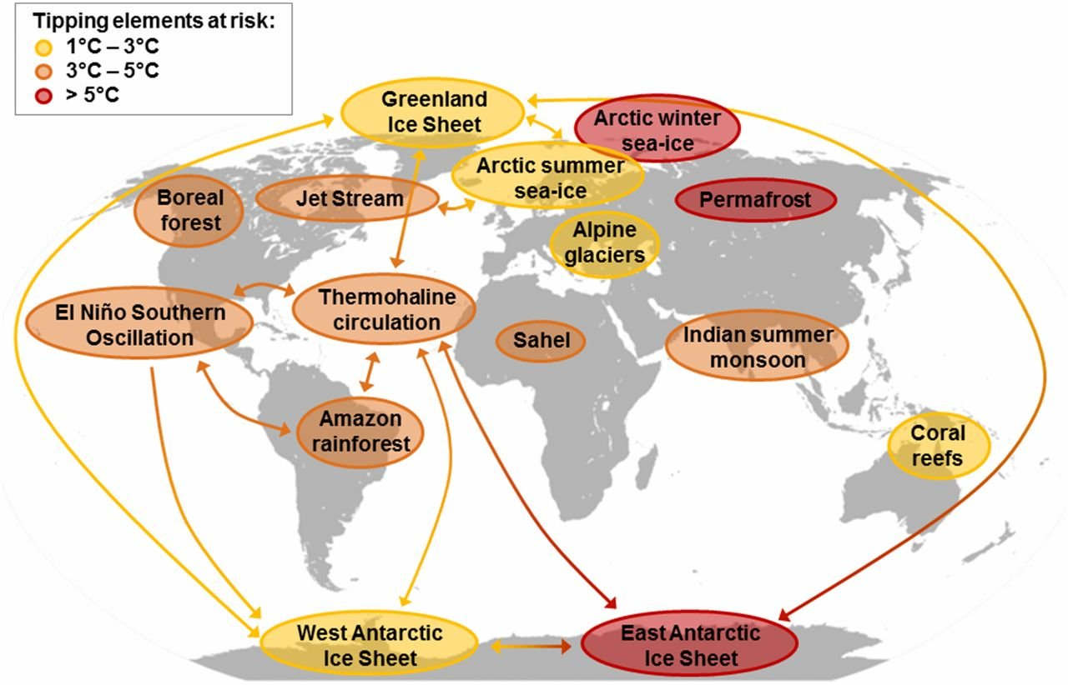
Week 4 – Models of discourse and the rhetoric of climate change: the importance of words
Introduced (by Lenton and coworkers) as “Tipping Elements” that have “Tipping Points” …
But I think in terms of “Sacrifice Zones” with 2-pronged “Sacrifice Thresholds”
Physical threshold (temperature at which positive feedbacks take over, requiring no more action by humans)
Otherization threshold (point at which elites succeed in otherizing those sacrificed)

Slide 7
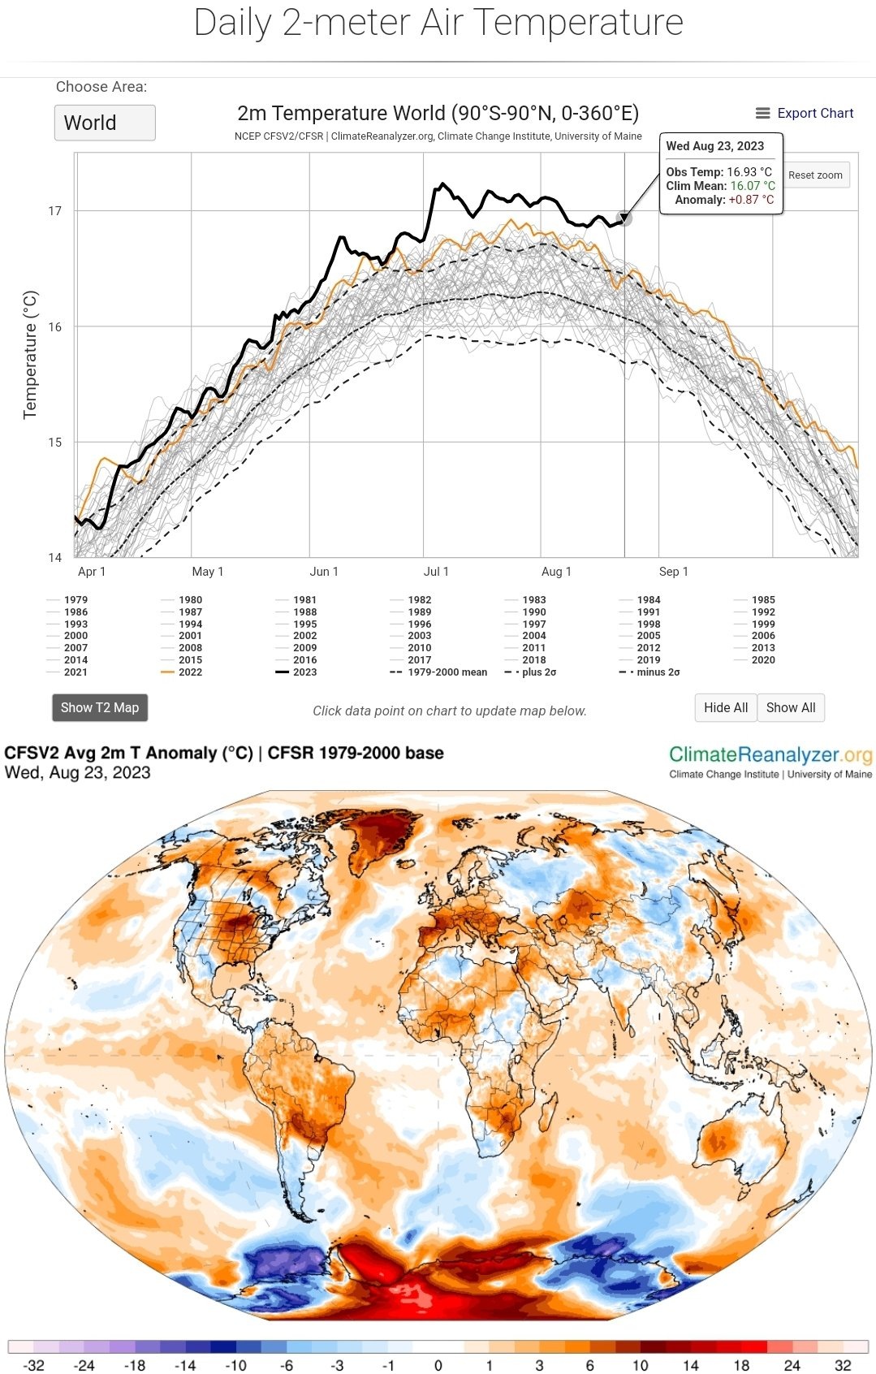
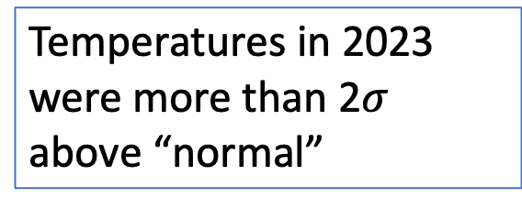
Week 4 – Models of discourse and the rhetoric of climate change: Polar amplification
Temperatures in 2023 were more than 2$σ$ above “normal”
The poles are getting especially hammered

Slide 8
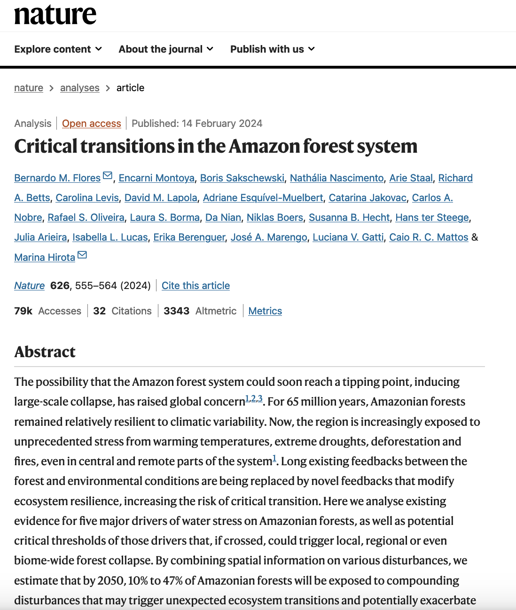
Week 4 – Models of discourse and the rhetoric of climate change: Amazon rainforest vulnerability
(2019)

Slide 9
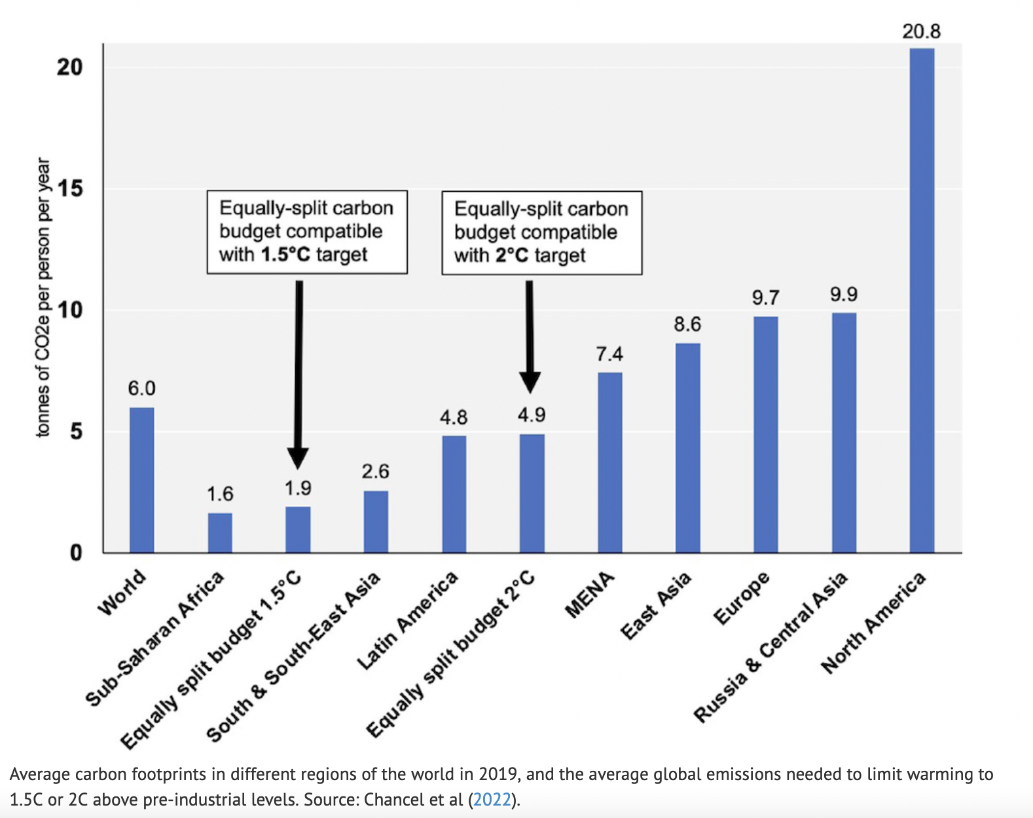
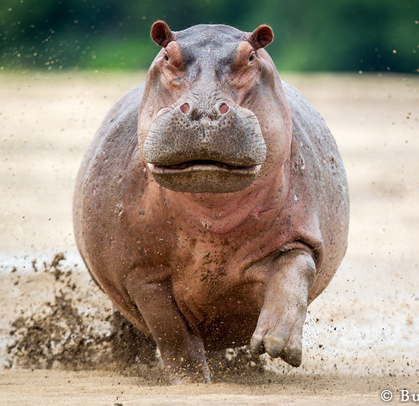
Week 4 - Chancel, 2022: Per-capita budgets needed to avoid 2 degrees warming
16 GtC/yr

Slide 10
Week 4 - Schrepfer’s power analysis method of analyzing of claims
Ask three questions:
How does it function? (Or: What is its goal?)
Who does it benefit?
Where is the power?
Example … in this course …

Slide 11
Week 4 - Rowe’s replacement method for analyzing claims
Explore an idea by replacing one word or concept with another, to see how it sits.
Statement #1:
"It's a waste of time to take individual action to oppose climate change, because it's embedded in the way our economy and culture work; only collective action has any chance of working."
Statement #2:
"It's a waste of time to take individual action to oppose white supremacy, because it's embedded in the way our economy and culture work; only collective action has any chance of working."

Slide 12
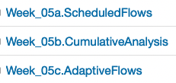
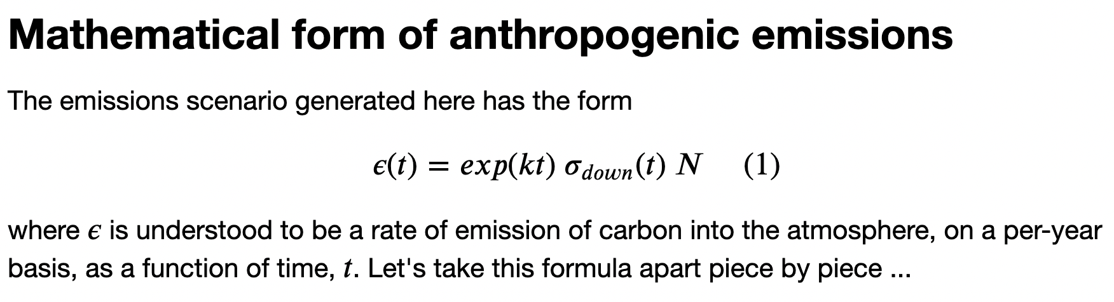
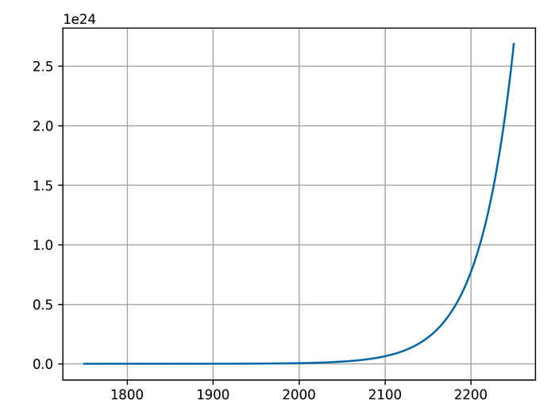
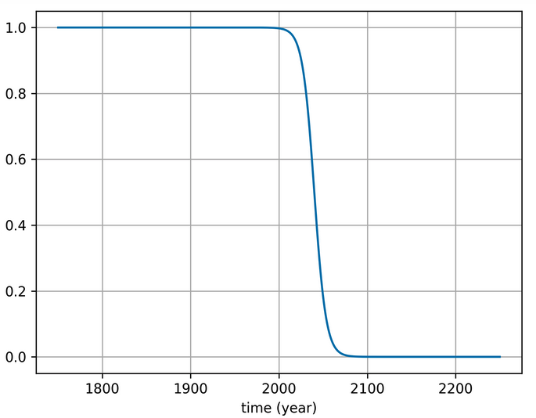
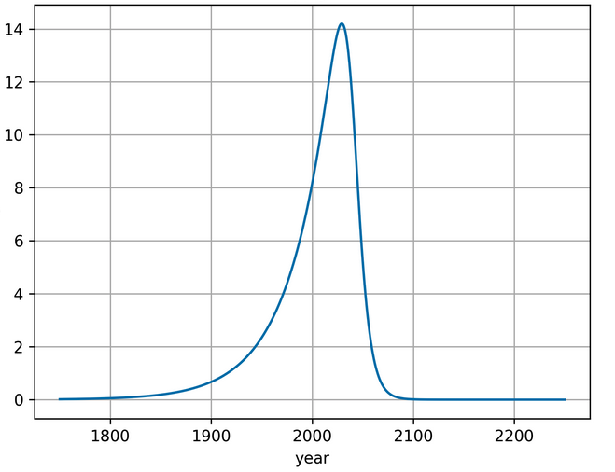
Week 5 - Scheduled and adaptive flows

Slide 13
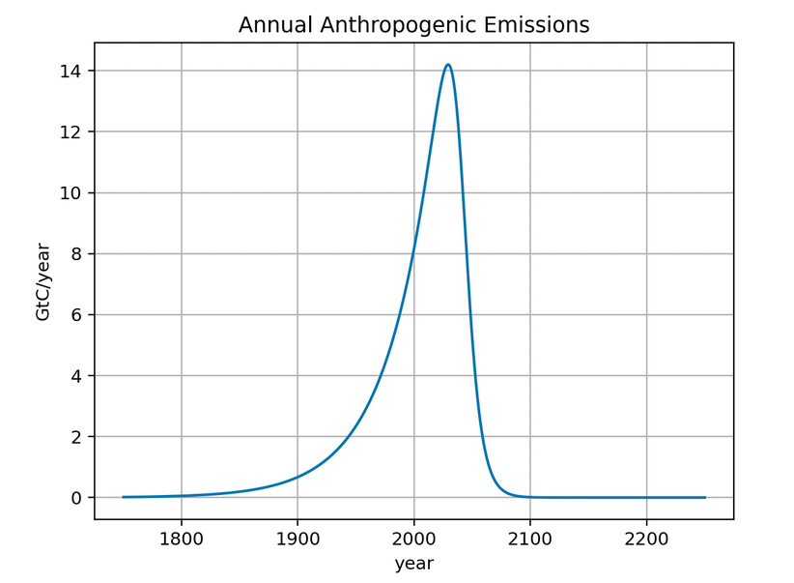
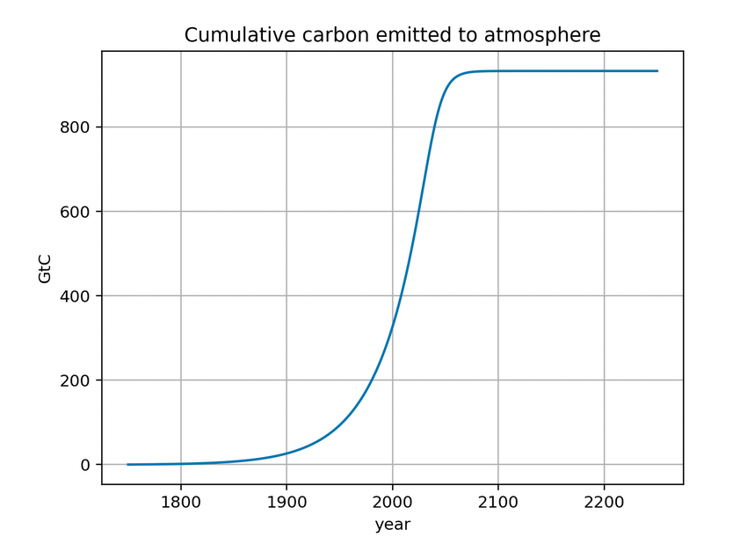
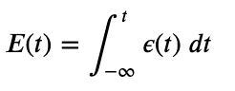
Week 5 - Scheduled and adaptive flows

Slide 14
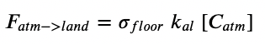
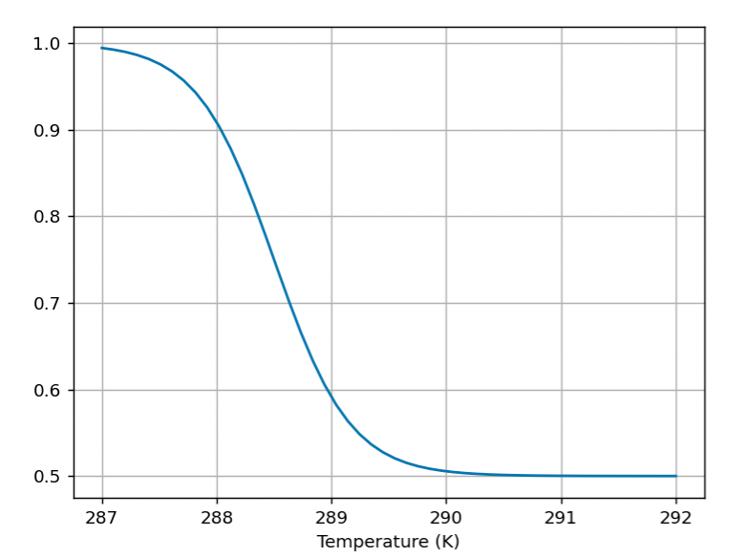
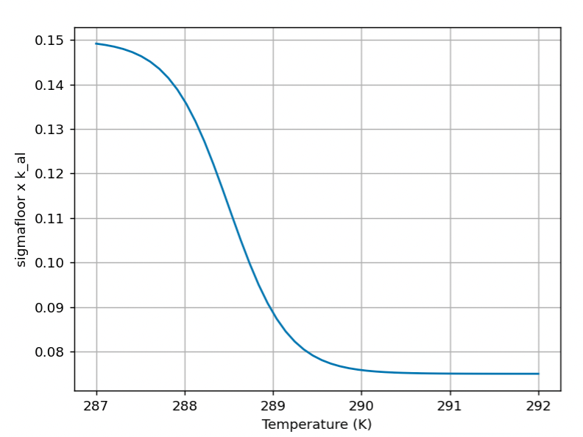
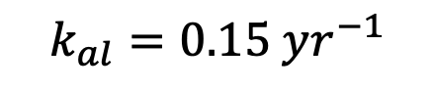
Week 5 - Scheduled and adaptive flows
$$k_{al}=0.15 yr^{−1}$$

Slide 15
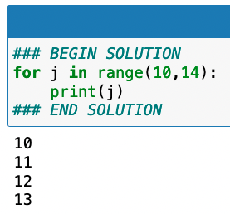
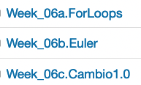
Week 6 – A carbon mass balance box model

Slide 16
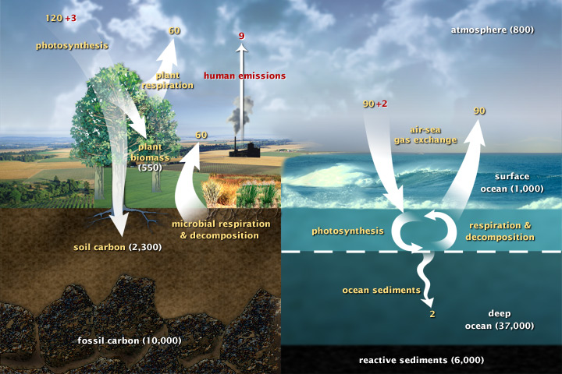
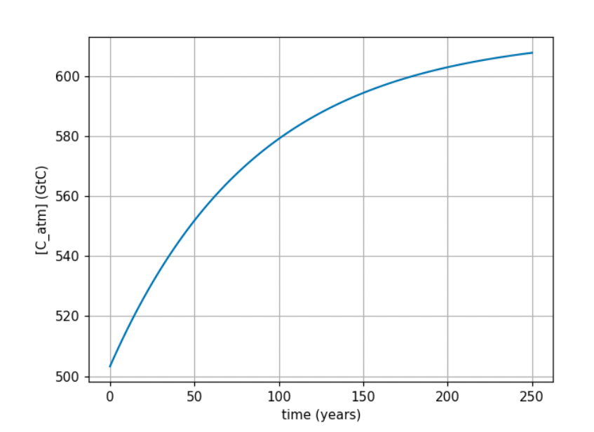
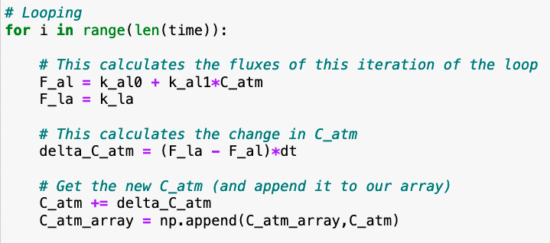
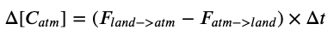
Week 6 – A carbon mass balance box model

Slide 17
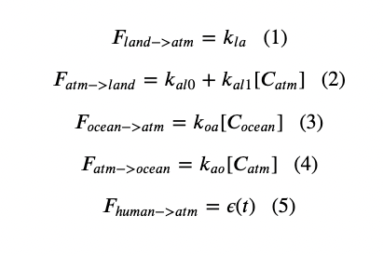
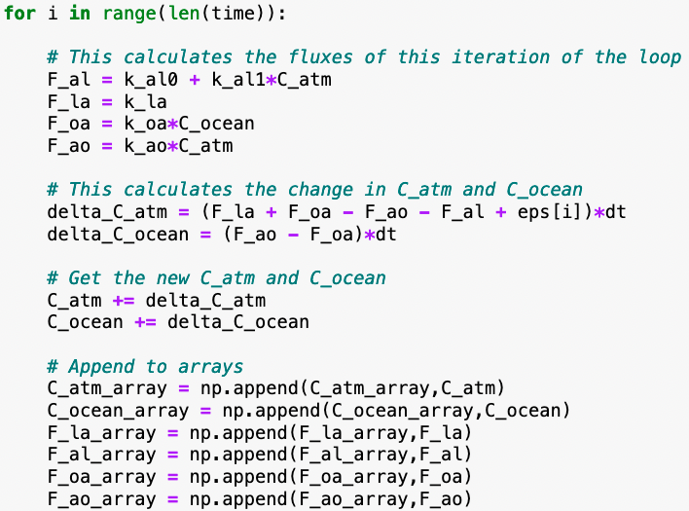
Week 6 – A carbon mass balance box model

Slide 18

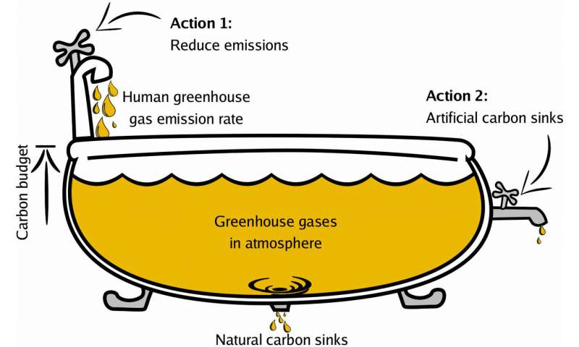
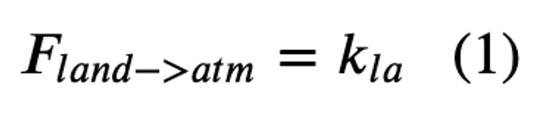
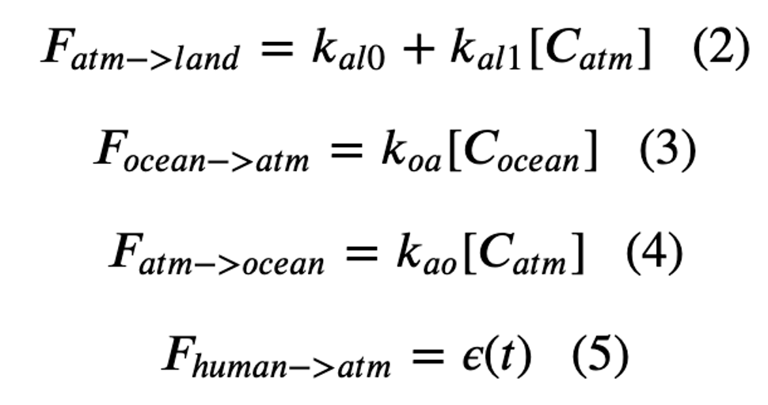
Week 6 – A carbon mass balance box model

Slide 19
Week 6 – A carbon mass balance box model

Slide 20
Week 6 – A carbon mass balance box model

Slide 21
Week 6 – A carbon mass balance box model

Slide 22
Week 6 – A carbon mass balance box model

Slide 23
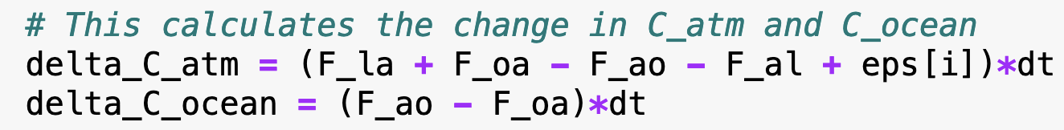
Week 6 – A carbon mass balance box model

Slide 24
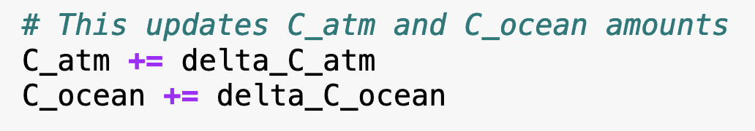
Week 6 – A carbon mass balance box model

Slide 25
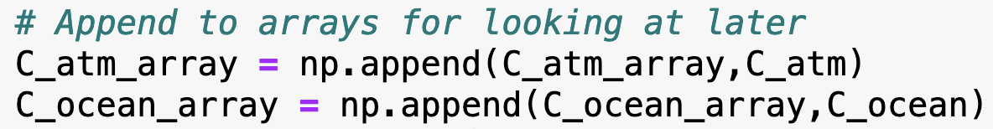
Week 6 – A carbon mass balance box model

